Slide 1
CHAPTER 1 : LEARN TO LEARN
Roles & Values at PNC

Slide 2

OBJECTIVES FOR THIS SESSION
What are the TRAINER ROLES during a class ?
What are the STUDENT ROLES in school life?
How can I apply PN VALUES during my school life ?

Slide 3


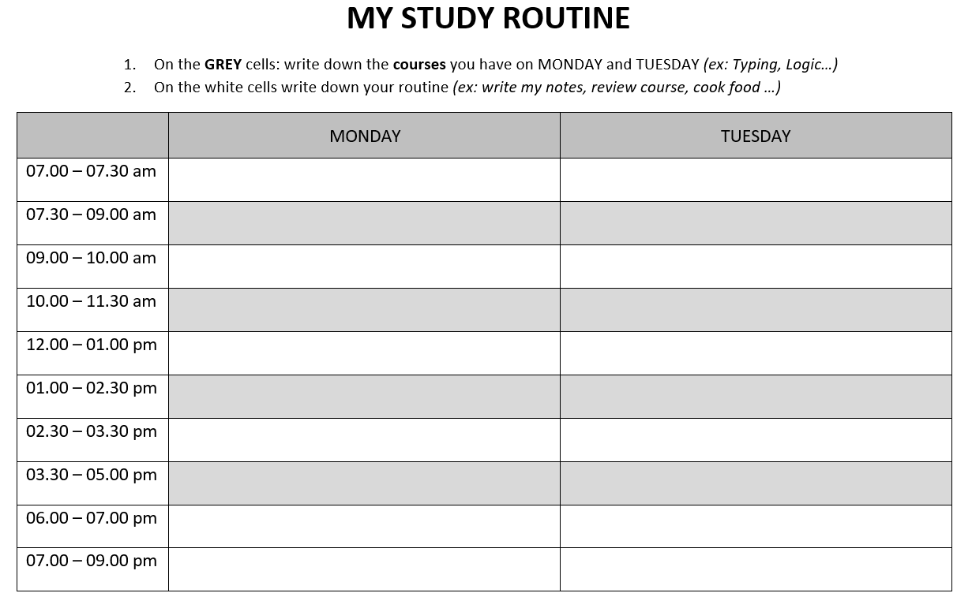
HOMEWORK
HOMEWORK REVIEW
Compare your schedule with other classmates

Slide 4




EXPLAIN
05 MIN
During a class, we have different moments…
We start the class
We learn something
We start
a group work
We don’t understand
We present our work
We check our understanding

Slide 5

ACTIVITY 1
For each moments, what are the trainer’s roles ?
20 MIN
We start the class
We learn something
We start
a group work
We don’t understand
We present our work
We check our understanding
Guide
to the solution
1
MAKE TEAMS !!
2
DISCUSS IN TEAM !!
3
PRESENT TO THE CLASS !!
TO COMPLETE THIS ACTIVITY :
3 students per team
1 speaker, 1 note taker
10 min
10 min

Slide 6





EXPLAIN
The trainer’s roles
10 MIN
We start the class
We learn something
We start
a group work
We don’t understand
We present our work
We check our understanding
Students
Motivator
Information
Provider
Activity
Organizer
Guide
to the solution
Work
Evaluator

Slide 7





ACTIVITY 2
Your roles as a PNC student !
10 MIN
For each role, find a definition and a example of situation where you can apply it – See example
Decision
Maker
Searcher
Organizer
Advisor
Evaluator
Make decisions
DEFINITION
EXAMPLE OF
SITUATION
Organize a party

Slide 8
EXPLAIN
Your roles as a PNC student !
05 MIN
For each role, find a definition and a example of situation where you can apply it – See example
Decision
Maker
Searcher
Organizer
Advisor
Evaluator
Search solutions to a problem
Organize work in team
Make decisions
Advice other students
Evaluate a work
DEFINITION
Find something
we don’t know
Team leader in a project
`Organize a party
Help to understand a problem
Review my friends work
EXAMPLE OF
SITUATION

Slide 9


EXPLAIN
10 MIN
During PNC school life, we have different moments…
DURING CLASS
AFTER CLASS
DURING WEEK ENDS
Listen teacher explanation
Do an activity alone
Do an activity in group
Do an exam
Review with peers
Do homework alone
Do a project in group
Clean the school
Join a club
Organize an event

Slide 10
ACTIVITY 3
10 MIN
Which PN values can you apply to each moment ?
TRUST
RESPECT
SOLIDARITY
HIGHT EXPECTATION
RESPONSABILITY
DURING CLASS
AFTER CLASS
DURING WEEK ENDS
Listen teacher explanation
Do an activity alone
Do an activity in group
Do an exam
Review with peers
Do homework alone
Do a project in group
Clean the school
Join a club
Organize an event
TO COMPLETE THIS ACTIVITY :
1
1 PAPER PER TEAM
2
DRAW LINE TO CONNECT MOMENTS TO PN VALUES
3
SHARE

Slide 11
EXPLAIN
10 MIN
Which PN values can you apply on each moment ?
DURING CLASS
AFTER CLASS
DURING WEEK ENDS
RESPECT
SOLIDARITY
Listen teacher explanation
Do an activity alone
Do an activity in group
Do an exam
Review with peers
Do homework alone
Do a project in group
Clean the school
Join a club
Organize an event
TRUST
HIGHT EXPECTATION
RESPONSABILITY

Slide 12
DISCUSS
10 MIN
What did we learn ?
1
Draw on flip chart a mind map representing the key words of this lesson and their relationship
DRAW
2
Present your flip char to another group
SHARE

